Slide 1
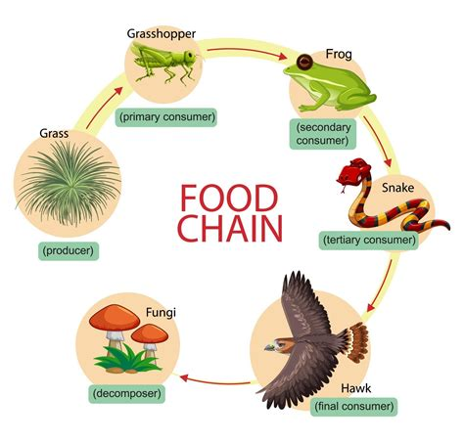
Ecosystems – Page 1
Imagine a world filled with millions of different species. This rich biodiversity can be overwhelming to understand and study. To make it easier, scientists use a system called classification. This is like having a big, vast library of life, where each creature is a unique book. A system similar to the Linnaeus classification system helps organize these 'books' into different sections or categories, such as mammals, birds, or insects. This way, they can better study and understand the complex world of organisms around us.
What is the purpose of classification in biology? ___________________________________________________________________
What are some examples of categories used in biological classification? ___________________________________________________________________
How is the classification of organisms similar to organizing books in a library? ___________________________________________________________________
Organisms in an ecosystem do not exist in isolation; they interact with each other in many ways. One of these interactions can be explained using food chains. In a food chain, energy is passed from one organism to another. For instance, a rabbit eats grass, a fox eats the rabbit, and a wolf eats the fox. Each link in this chain is important for the balance of the ecosystem.
What is a food chain? ___________________________________________________________________
How does energy move through a food chain? ___________________________________________________________________
Can you think of another example of a food chain? ___________________________________________________________________ ___________________________________________________________________

Slide 2
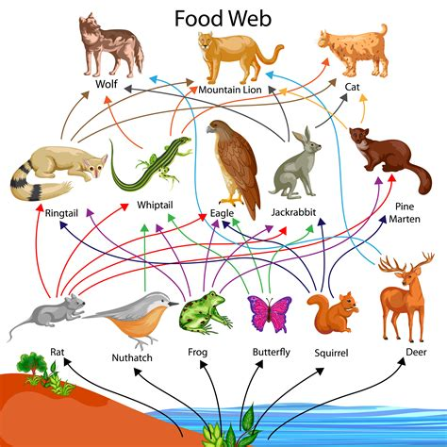
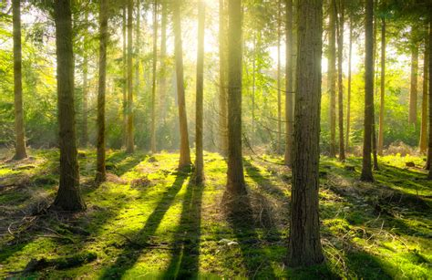
Ecosystems – Page 2
While food chains are a great way to understand energy flow, they are often too simplistic. In reality, organisms are part of multiple food chains, creating a more complex network known as a food web. If a food chain is like a single path, a food web is like a busy highway system, where many paths intersect. It represents how each creature in an ecosystem is interconnected, contributing to the overall balance and survival of different species.
How is a food web different to a food chain? __________________________________________________________________
Why do scientists use food webs to study ecosystems? __________________________________________________________________
What happens in a food web if a species becomes extinct? __________________________________________________________________
Human activity can significantly affect the balance of ecosystems. For instance, deforestation can disrupt food chains and food webs by removing a habitat for various species. Pollution can harm or kill organisms, creating gaps in the food web. It is essential to understand these impacts and work towards sustainable practices to ensure the health and survival of our planet's diverse ecosystems.
How can human activity affect food chains and food webs? __________________________________________________________________
How does deforestation impact an ecosystem? __________________________________________________________________
Why is it important for humans to understand and maintain the balance of ecosystems? __________________________________________________________________

